Slide 1
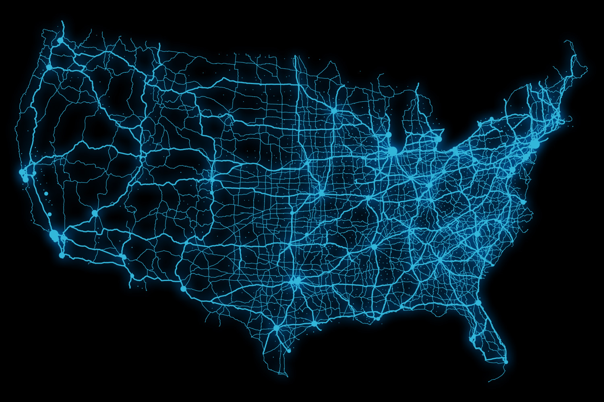
The Electrification Coalition Revolutionizing Transportation and Achieving Energy Security

Slide 2
Energy Security is Again Front and Center
Volatile oil prices and geopolitical instability in oil-producing regions are moving energy security back to the forefront of the political dialogue.
BENCHMARK SPOT CRUDE OIL PRICES
The U.S. is at a pivotal moment in energy security policy. Oil prices are recovering from a recession-induced collapse and are being driven up by geopolitical factors we do not control.
While the current spike over $100/bbl is fairly likely to recede, oil prices are unlikely to return to 2000-2004 price levels again in the short to medium term.

Slide 3
The Economic Recovery is at Risk
Historically, high oil prices have been economically damaging. Oil spending over 4 percent of GDP has occurred concurrently with past recessions.
CRUDE OIL COSTS: SHARE OF U.S. GDP
The oil intensity of the U.S. economy is about half of the 1974 level.
However, while we may be more resilient to high oil prices, spikes are occurring more frequently at high levels. The more important data point is oil spending as a share of GDP.
At between 4 and 5 percent of GDP, oil spending is again reaching levels typically associated with recession.
2011 DOE Est.
Source: BP, plc, Statistical Review of World Energy 2010; DOE, EIA; U.S. Bureau of Economic Analysis

Slide 4
Global Oil Market Dynamics—Demand
Oil consumption within the world’s most developed economies has peaked. Emerging markets account for 100 percent of demand growth going forward.
WORLD OIL CONSUMPTION (HISTORICAL AND FORECAST)
World oil demand is set to grow by about 22 percent over the next 20 years.
One hundred percent of that growth is in China, India, and other emerging economies. And 97 percent of it is in transportation.

Slide 5
Global Demand Drivers
Emerging markets are expected to account for 100 percent of future oil demand growth. This is largely driven by the transportation sector .
In 2009, China surpassed the United States to become the largest auto market in the world.
As vehicle sales increase exponentially, the number of cars on the road in China is soaring.
VEHICLE PRODUCTION, U.S. AND CHINA (HISTORICAL)
LIGHT-DUTY VEHICLE STOCK
Source: Department of Energy, Office of Energy Efficiency and Renewable Energy
Source: International Energy Agency, World Energy Outlook 2009

Slide 6
Global Oil Market Dynamics—Supply
Conventional oil production outside of OPEC has reached a plateau. Going forward, unconventionals and OPEC account for growth in liquid supplies.
WORLD OIL PRODUCTION (HISTORICAL AND FORECAST)
Two key questions illustrate the downside risk to growth in future liquid supplies:
1. Who will have access to low-cost conventional reserves?
2. What will reserves replacement cost for IOCs?

Slide 7
Defining Big Oil
Oil prices are set in an open market, but that does not mean there is a free market for oil supply.
TOP OIL AND GAS FIRMS BY PROVED RESERVES
More than 90 percent of global proved oil reserves are held by national oil companies (NOCs) that are either partially or fully controlled by governments.
The top 13 oil and gas reserve holders are all NOCs.
As a result of this reserve dominance, the world will count on NOCs to provide most of the increase in oil supplies going forward.
These companies do set output in the same way as profit maximizing firms in a competitive market.
Source: International Energy Agency, World Energy Outlook 2008

Slide 8
Future Oil Supplies—Heavier and More Costly
Resources in the Middle East and North Africa will be the least expensive to produce. However, they may also be the least accessible to IOCs.
LONG TERM OIL SUPPLY COST CURVE
COAL TO LIQUID
OIL SHALES
GAS TO LIQUID
ARCTIC
Production Costs (Real $2008 per Barrel)
CO₂ - EOR
DEEPWATER
HEAVY OIL & BITUMEN
EOR
OTHER CONV. OIL
PRODUCED
MIDDLE EAST
NORTH AFRICA
Resources (billions of barrels)
Source: International Energy Agency, World Energy Outlook 2008

Slide 9
U.S. Oil Dependence: Economic Costs
On a month-to-month basis, petroleum imports have typically accounted for about half of the total U.S. trade deficit since the end of 2007.
U.S. PETROLEUM TRADE DEFICIT
The portion of the trade deficit driven by petroleum imports generally exceeds the imbalance we run in other goods and services with trade partners like China, NAFTA, and the EU.
A high trade deficit exerts downward pressure on the dollar, which in turn may be helping to prop up oil prices, resulting in a vicious circle.

Slide 10
U.S. Oil Dependence: Economic Costs
The economic costs of U.S. oil dependence reached nearly $500 billion in 2008. Since 1970, total economic damage exceeds $5 trillion (real dollars).
In addition to staggering wealth transfers, high and volatile oil prices generate significant uncertainty for households and businesses. The result is lost economic opportunity.
ECONOMIC COSTS OF U.S. OIL DEPENDENCE
Source: DOE, EERE; ORNL

Slide 11
Features of the Electric Power Sector
Electrification of transportation is the best solution for sharply reducing U.S. oil dependence.
Electricity is generated from a diverse portfolio of domestic fuels.
Electricity prices are stable.
The power sector has substantial spare capacity.
The network of infrastructure already exists.
U.S. ELECTRICITY GENERATION BY FUEL, 2010
U.S. ELECTRICITY DEMAND BY SECTOR, 2010
Source: EIA, AEO 2010

Slide 12
Features of the Electric Power Sector
Electricity prices exhibit a high degree of stability over time. Economy-wide retail electricity prices have actually declined in real terms since 1980.
CHANGE IN RETAIL FUEL PRICES, HISTORICAL
Crude oil prices, and therefore retail petroleum fuel prices, have exhibited significant volatility for the past several years. High and volatile prices have adversely affected shipping companies, corporate fleets, and the broader economy.
In contrast, retail electricity prices have remained stable.

Slide 13
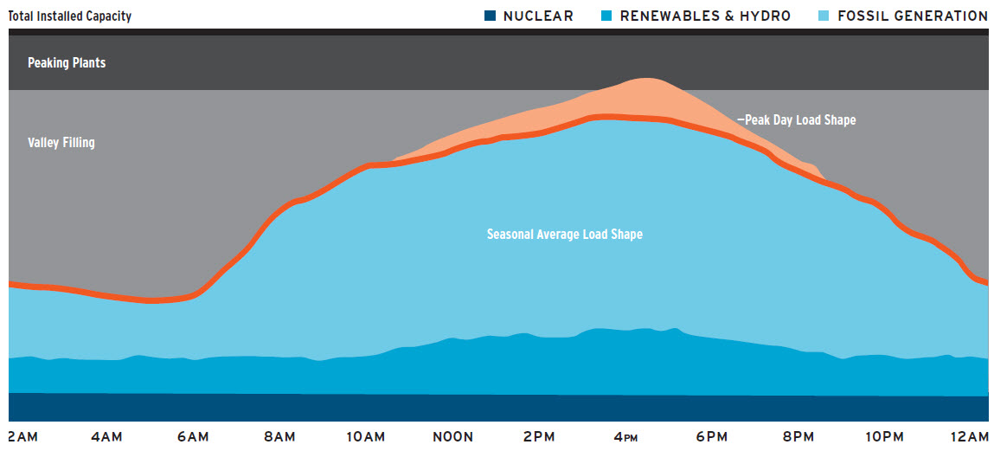
Electric Power Sector: Generation
The electric power sector has substantial spare capacity at night that could be used to fuel electric vehicles. By filling valleys, GEVs could lower costs.
LOAD SHAPE FOR ONE DAY DURING PEAK SEASON
Source: Pacific Northwest National Laboratory

Slide 14
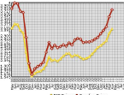
Alternative Fuels: Challenges
The two other primary alternatives to gasoline each present challenges of their own.
Biofuels
Price tracks gasoline price
No incentive to create spare capacity
Need separate fuel distribution system
Natural Gas
No fuel diversity
Less infrastructure currently in place
Power generation is more efficient use of natural gas than light duty vehicles
Source: E85prices.com

Slide 15
Grid-Enabled Vehicles: Production Capacity
A new generation of grid-enabled vehicles (GEVs) reached U.S. markets in 2010. North American production will ramp up in 2011.
The industry is beginning to scale up. Announced North American production capacity will already exceed 100,000 vehicles in 2012.
These figures do not include trucks.
Additional volumes will reach the U.S. market from OEM plants overseas, particularly in the next two years.
ANNOUNCED NORTH AMERICAN GEV PRODUCTION CAPACITY
Source: PRTM Estimates

Slide 16
Baseline Market Forecasts
Government and industry expectations for GEVs currently vary widely. Sales share estimates range from 1 to 10 percent—or more—by 2020.
Forecast variance mostly emanates from different assumptions regarding the pace of battery/component cost reductions.
Energy cost forecasts; lack of infrastructure; assumed future environmental policy; and guesses about consumer acceptance also play a role.
FORECAST EV AND PHEV PENETRATION IN 2020 (UNITED STATES)
Source: PRTM Estimates

Slide 17
Electrification Overview: Challenges
While electrification has promise as an energy strategy, it can only succeed if GEVs are attractive to the mass market and can integrate into the grid.
Batteries and Vehicles With the advent of lithium-ion battery technology, the largest obstacle to widespread consumer adoption of these vehicles will be cost, though performance and raw material supply chains are also important to consider. Need innovative business models, manufacturing scale in gen-1/2, and R&D for Gen-3.
Charging Infrastructure A profitable business model for public charging points has not been reliably demonstrated, and we do not yet know how much public charging will be needed.
Electric Power Sector Interface While “smart” charging will make electric vehicles an asset to the grid, “dumb” charging will make them a liability.
Consumer Acceptance GEVs represent a significant shift in technology. In order to change mainstream consumer attitudes, GEVs must offer a compelling alternative to conventional IC engines on either cost or performance grounds.

Slide 18
Battery/Vehicle: Total Cost of Ownership
Despite higher upfront costs, lower fuel and maintenance costs can make electric drive an economically compelling option for some consumers.
Over a ten year 120,000 mile vehicle life, existing tax incentives should make EVs balance positive today compared to ICE.
On a ‘should cost’ basis, the case is slightly stronger for a PHEV right now, but lifecycle EV costs will catch up by 2016.
GAS vs. EV: TOTAL COST OF OWNERSHIP (¢ PER MILE)
GAS vs. PHEV: TOTAL COST OF OWNERSHIP (¢ PER MILE)
Source: EC Roadmap; PRTM Analysis

Slide 19
Battery/Vehicle: Battery Costs
We are nearing the end of the first phase of battery cost reductions related to today’s EVs and PHEVs. Scale and volume production are key today.
The cost of the battery contributes as much as one-third of the cost of light-duty electric vehicles. The share is higher in truck applications.
LARGE FORMAT LITHIUM ION BATTERY COST ($/KWH)
Source: EC Roadmap; PRTM Analysis

Slide 20
Cost Reduction Scenarios
Capital costs are currently the largest obstacle to electric vehicle adoption. However, battery and component costs are falling as gasoline prices rise.
PAYBACK PERIOD FOR A PHEV-40 (INCLUDING ARRA INCENTIVES)
As battery costs come down, the value proposition will get stronger. By mid-decade, PHEVs and EVs could present drivers with an economically compelling option.
The pace at which this happens depends on a variety of assumptions.
Consumers typically want a 3-year payback for investments in efficiency.

Slide 21
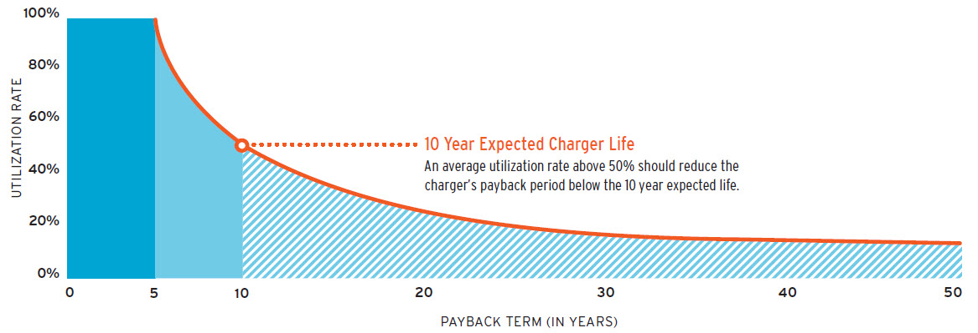
Charging Infrastructure: Business Model
Investment in widespread public (shared) charging infrastructure is a risky proposition. The appropriate strategy and business models are unknown.
PAYBACK PERIOD FOR A SINGLE PUBLIC CHARGER IN A ‘BUSINESS AS USUAL’ CASE
Source: EC Roadmap; PRTM Analysis

Slide 22
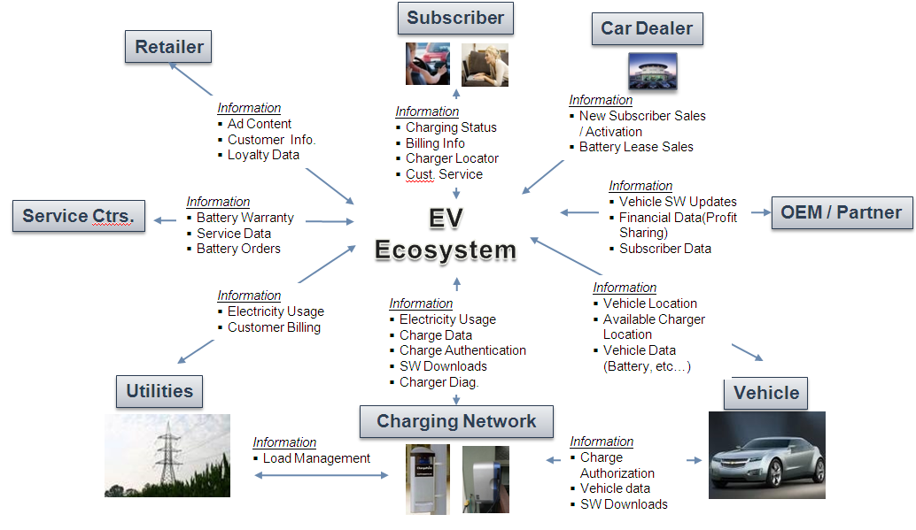
Consumer Acceptance: The GEV Ecosystem
A complete electric drive ecosystem has a myriad of stakeholders, not simply OEMs and consumers. Utilities, dealers and others will have a role.
Notes:
Consumer acceptance:
Pint here is that EVs and PHEVs will represent a new experience for consumers. For it all to work well, an integrated system including a charge network, utilities, service centers, and other players will need to be present.
Without that network, electric drive technology will be relegated to a niche application that does little for energy and/or economic security.

Slide 23
Consumer Acceptance: Key Uncertainties
While the first generation of grid-enabled vehicles will be able to meet average consumer needs on average trips, most of us don’t think that way.
COST AND CONVENIENCE
PERFORMANCE AND TECHNOLOGY
The payback period for EVs and PHEVs are probably still too high
There are approximately 150,000 gasoline stations nationwide; consumers are used to convenience
Level II charging at home and in public will not allow mass adoption; some kind of intercity refuel option will be needed—Level III or battery swap
Life of the battery/vehicle and warranty may be different than ICE
EVs and PHEVs will perform differently than ICE vehicles
GEVs have better torque and acceleration, but reduced range and longer refueling times
GEVs are much quieter than ICEs, but not all consumer value that
Will the ecosystem arrive?

Slide 24
Key Policy: Deployment Communities
To overcome these challenges, lawmakers should initiate an ambitious program to support mass deployment in a limited number of communities.
FEATURES AND ADVANTAGES OF DEPLOYMENT COMMUNITY APPROACH
Focusing on targeted regional deployment accomplishes at least three objectives:
Demonstrate Proof of Concept for Consumers
Facilitate Learning by Doing
Maximize Investment Payoff
Grid-enabled vehicles require a network built on public-private coordination in order to thrive. Technology promotion has to be about more than throwing money at a problem.
The deployment community approach recognizes that a widespread national rollout without careful planning will reduce the likelihood that GEVs can penetrate the mass market, instead being relegated to niche market status (as has happened with hybrid vehicles, 1.6 million of which have been sold over the past 11 years out of a light-duty fleet of 250 million vehicles).

Slide 25
Getting Ready for Plug-In Vehicles
There are a range of activities that regions can take to prepare for the arrival of plug-in vehicles
New electricity pricing models
Process in place to ensure transformers are upgraded as needed
Address issue of whether sale of power for vehicle charging is regulated activity
Utility customer service
Streamline EVSE permitting
Update building codes
Other preferences for plug-in vehicle drivers (parking, HOV lanes)
Organization

Slide 26
Electric Power Sector: Generation
Price signals will be critical to maximize the efficiency of the grid and avoid excessive investments in new generation and distribution equipment.
A number of utilities, including PG&E, Detroit Edison, and Alaska Electric Light and Power have announced that they are planning or implementing special EV rate pilot programs.
 |  | 12:00 Midnight | 7:00 AM | 2:00 PM |  | 9:00 PM | 12:00 Midnight
Monday
Tuesday |  | Off Peak | Partial Peak | Peak
Wednesday |  | 5.0 cents/kWh | 10.4 cents/kWh | 28.4 cents/kWh |  | Partial
Thursday |  | 5.6 cents/kWh | 10.0 cents/kWh | 28.0 cents/kWh |  | Peak
Friday
Saturday |  |  |  |  | Partial | Off Peak
Sunday |  |  |  |  | Peak
 |  |  |  |  | 5:00 PM | 9:00 PM
SAMPLE ELECTRIC VEHICLE RATE PLAN (PG&E)
Source: PG&E

Slide 27
Getting Ready for Plug-In Vehicles
There are a range of activities that regions can take to prepare for the arrival of plug-in vehicles
Source: EPRI, PG&E

Slide 28
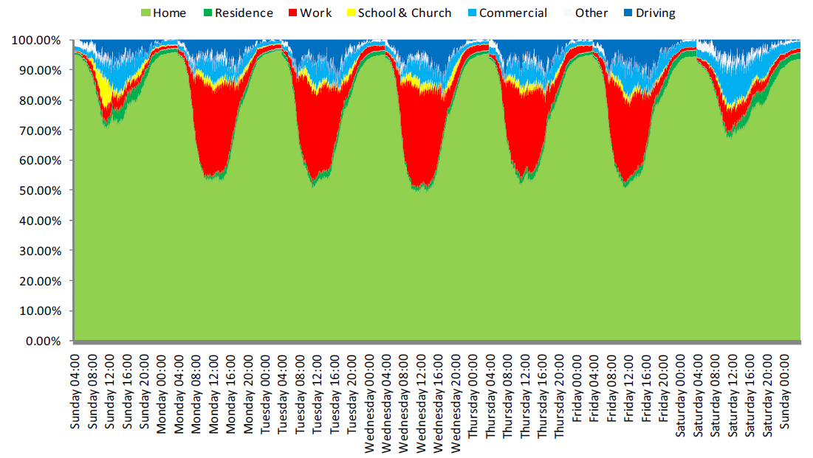
Getting Ready for Plug-In Vehicles
Where vehicles spend their time
Source: SAE

Slide 30
World Oil Consumption
The United States is the world’s largest oil consumer, accounting for one-fourth of global oil demand. The majority—70 percent—is used in transport.
TOP WORLD OIL CONSUMERS, 2009
At 18.6 million barrels per day, the U.S. was the world’s largest consumer of petroleum in 2009, using about three times as much as China. Between 2005 and 2009, U.S. oil demand averaged 20.1 million barrels per day.
The U.S. transport sector alone consumes more oil than any national economy in the world.

Slide 31
World Oil Production
The United States is the world’s third largest producer of oil. However, domestic production has fallen sharply since its peak in 1970.
TOP WORLD OIL PRODUCERS, 2009
After decades of decline, U.S. field production of crude oil and natural gas liquids was up from 6.7 mbd in 2008 to 7.2 mbd in 2009. Production increased again in 2010 to 7.5 mbd.
Still, this level marks a sharp decline from the 1970 level of 11.3 mbd. Well productivity is also down from 18.1 barrels per day per well in 1970 to 10.1 barrels per day in 2009.

Slide 32
IOC Production: More Unconventionals
The oil and gas resources available to traditional energy companies are increasingly unconventional, resulting in rising output from these sources.
OIL MAJORS: SHARE OF UNCONVENTIONAL SUPPLIES IN OIL AND GAS OUTPUT
The share of unconventional resources like oil sands, bitumen, gas-to-liquid, and oil shale has been steadily rising as a portion of most oil majors’ total output.
The trend is expected to continue across the board an to accelerate in many cases.
Source: Bernstein Research

Slide 33
The Challenge: Replacing Today’s Resources
As conventional oil supplies become more difficult and costly to access, the challenge of replacing currently-producing oil fields will become paramount.
WORLD OIL PRODUCTION BY SOURCE (HISTORICAL AND FORECAST)
Conventional oilfields experience natural decline rates that vary from 6 to 10 percent depending on maintenance.
The oil fields supplying us with petroleum today need to be continuously replaced. Going forward, un-conventionals will play a bigger role.
Source: International Energy Agency, World Energy Outlook 2010

Slide 34
U.S. Oil Dependence
Petroleum fuels account for approximately 40 percent of U.S. primary energy demand, more than any other fuel.
Approximately 70 percent of U.S. oil consumption occurs in the transportation sector, with 40 percent in light-duty vehicles.
Transportation is 94 percent reliant on oil-based fuel for energy, with no scaled substitutes.
U.S. PRIMARY ENERGY DEMAND, 2009
PETROLEUM FUEL DEMAND BY SECTOR, 2009

Slide 35
U.S. Oil Dependence: Imports
U.S. oil supplies are acquired from a variety of sources, including domestic crude oil and natural gas liquids, biofuels, refinery gains, and imports.
U.S. OIL CONSUMPTION (HISTORICAL AND FORECAST)
Net imports, once a small fraction of U.S. supplies, currently meet more than half of total U.S. liquid fuel demand.
Uncertainty exists about future import levels. Current DOE forecasts show imports falling as domestic supplies increase.

Slide 36
U.S. Oil Dependence: National Security Costs
The importance of oil in the U.S. economy has given it a place of prominence in foreign and military policy.
GLOBAL OIL SHIPPING CHOKEPOINTS, 2009
Two issues related to oil affect national security:
The vulnerability of global oil supply lines and infrastructure has driven the United States to accept the burden of securing the world’s oil supply.
The importance of large individual oil producers constrains U.S. foreign policy options when dealing with problems in these nations.

